Slide 1
SAILS.P.402 | INDUSTRIAL PROJECT
QSAR Bioactivity Prediction
A comparative regression and classification study using Morgan fingerprints and SHAP-based feature attribution
Shivananda Reddy Kasula
Register Number 39958
Faculty Mentor: Shyam Rajagopalan
IBAB & Biocon Academy · August 2026

Slide 2
Contents
Introduction
Slides 3–5
Literature Support
Slides 6–8
1
2
Drug discovery, the QSAR premise, and the objectives
The published basis for every methodological choice made
Methodology
Slides 9–11
Results
Slides 12–15
3
4
Dataset, representation, modelling, validation and metrics
Regression, feature selection, SHAP, classification
Discussion
Slides 16–18
Conclusion
Slides 19
5
6
What the F1 scores mean, and the limitations of the work
Findings and recommended future work

Slide 3
1 · INTRODUCTION
Why QSAR? The problem it solves
Finding a new drug is slow, expensive, and fails most of the time
$2.6B
~7%
<1%
Average cost to bring a single drug to market
Of compounds entering Phase I trials ever reach approval
Hit rate when a compound library is screened in the lab
The QSAR idea
A molecule's structure determines what it does. A machine learning model can learn that structure–activity relationship from compounds whose activity has already been measured, then predict activity for untested molecules in seconds — so only the most promising few ever reach the bench.

Slide 4
2 · LITERATURE SUPPORT
6
Literature support for the representation
Why Morgan fingerprints at radius 2 were the right encoding for this dataset
1964
Late 1980s
2010
Hansch & Fujita
3D-QSAR
Rogers & Hahn
Established QSAR as quantitative. Linear in a few interpretable constants, confined to congeneric series — too narrow for a diverse dataset.
Captures shape and electrostatics, but requires a reliable alignment hypothesis. Not available for a blinded target.
Extended-connectivity fingerprints: atom identifiers iteratively hashed with neighbours, folded into a fixed bit vector. Now the default for machine-learned QSAR.
Justification for this choice
Known limitation, acknowledged
Benchmarks including MoleculeNet (Wu et al., 2018) report fingerprint-based ensembles competitive with learned graph representations below roughly ten thousand compounds. At ~2,350 compounds, fingerprints are the appropriate choice.
Folding introduces bit collisions, and a bit index carries no chemical meaning without the bit-information mapping. This constrains the interpretability results reported in Section 4.

Slide 5
3 · METHODOLOGY
9
Dataset and preprocessing
A blinded industrial dataset of curated bioactivity measurements
2,700
~2,350
1,645 / 705
records as supplied
unique compounds after deduplication
training and test compounds
Preprocessing steps
The target was not disclosed
Exploratory analysis of dimensions, types, nulls and target distribution
Molecule identifier column dropped — no chemical information
Duplicate SMILES removed, preventing contamination across the split
pChEMBL retained as continuous target; dichotomised at ≥ 5 (10 µM)
70:30 partition with fixed seed, giving a 705-compound test set
The dataset was supplied in blinded form, with structures and activity values retained but the target, assay types and therapeutic context withheld.
Consequences: the literature support is methodological rather than target-specific; SHAP results cannot be checked against a known binding site; internal validation carries the full weight of the assessment.
One advantage: with no prior expectation of which substructures should matter, the interpretability findings could not be steered towards confirming a hypothesis.

Slide 6
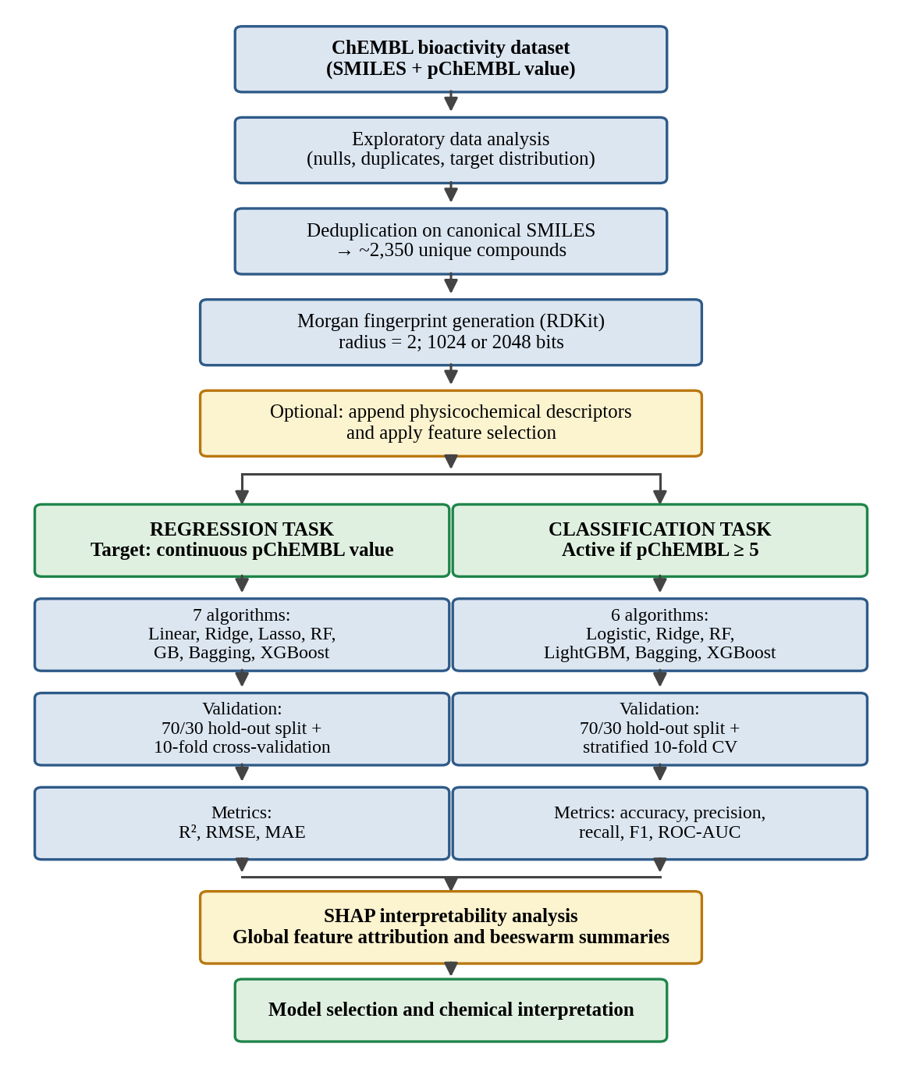
3 · METHODOLOGY
10
Computational workflow
One preprocessing pipeline feeding two parallel modelling tasks
Regression task
Software
Target: the continuous pChEMBL value, preserving the full information content of the measurement.
RDKit for chemistry; scikit-learn for models, validation and metrics; XGBoost and LightGBM; SHAP; pandas, NumPy, Matplotlib.
Classification task
Shared pipeline
Target: binary activity at pChEMBL ≥ 5, a conventional if permissive criterion for measurable activity.
Both branches share every preprocessing step, so any difference in outcome is attributable to the task formulation rather than to the data.

Slide 7
3 · METHODOLOGY
12
How a molecule becomes a number
One worked example: aspirin, from text to model-ready features
1 · The input
2 · The structure
3 · The fingerprint
4 · Ready to model
COOH
CC(=O)Oc1ccccc1C(=O)O
OCOCH₃
2,350 × 1024
1 0 0 1 0 … × 1024 bits
compounds × features
one atom + its neighbours
A SMILES string. The whole molecule, written as one line of ordinary text.
The same information, drawn. RDKit rebuilds the molecular graph from the text.
Every neighbourhood becomes one bit: present or absent. Now it is just numbers.
A plain numeric table — ready to feed into any machine learning model.
Everything after step 1 is arithmetic. Thousands of candidate molecules can be scored and ranked in minutes — before a single one is synthesised or assayed.

Slide 8
3 · METHODOLOGY
11
Modelling, validation and metrics
Library defaults except where grid search is explicitly reported
Algorithms
Feature selection
Validation
Regression (7): Linear, Ridge, Lasso, Random Forest, Gradient Boosting, Bagging, XGBoost.
Classification (6): Logistic, Ridge, Random Forest, LightGBM, Bagging, XGBoost.
Four families appear in both, permitting direct comparison of the same inductive bias across formulations.
Nine configurations: raw fingerprint at 1024 and 2048 bits ± descriptors; variance thresholding at 0.00 and 0.01; PCA at 95% variance and 200 components; Lasso selection; and SHAP-guided selection of the top 50 to 350 features.
Hold-out: 70:30 split, seed 7, giving 705 test compounds.
Cross-validation: ten folds, stratified for classification so class proportions are preserved in every fold.
Grid search: exhaustive, five-fold, scored on R².
Metrics
Regression: R², RMSE and MAE. Classification: precision, recall and F1 for the active class, plus ROC-AUC — with sensitivity and specificity reported separately, since a single-class F1 tells us nothing about the minority class.

Slide 9
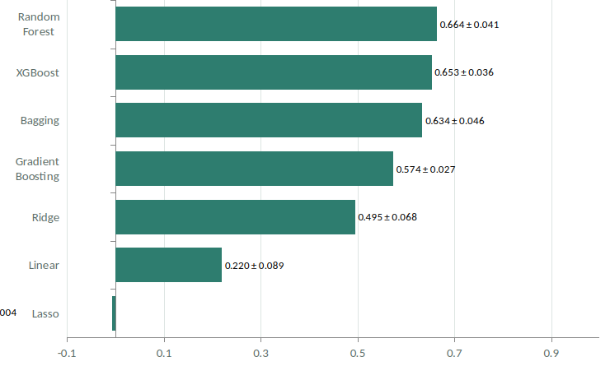
4 · RESULTS
12
Regression performance
Ten-fold cross-validated R² on the 1024-bit Morgan fingerprint · values shown as mean ± 1 SD across folds
0.664, std 0.04
Random Forest R² · RMSE 0.655 log units
XGBoost (0.653) and Bagging (0.634) lie within one standard deviation. Tree ensembles as a class win — no single ensemble is demonstrably superior.
The two failures
Lasso collapses to its intercept under the default L1 penalty. Unregularised Linear Regression is unstable with 1024 correlated features. The right amount of regularisation is intermediate.

Slide 10
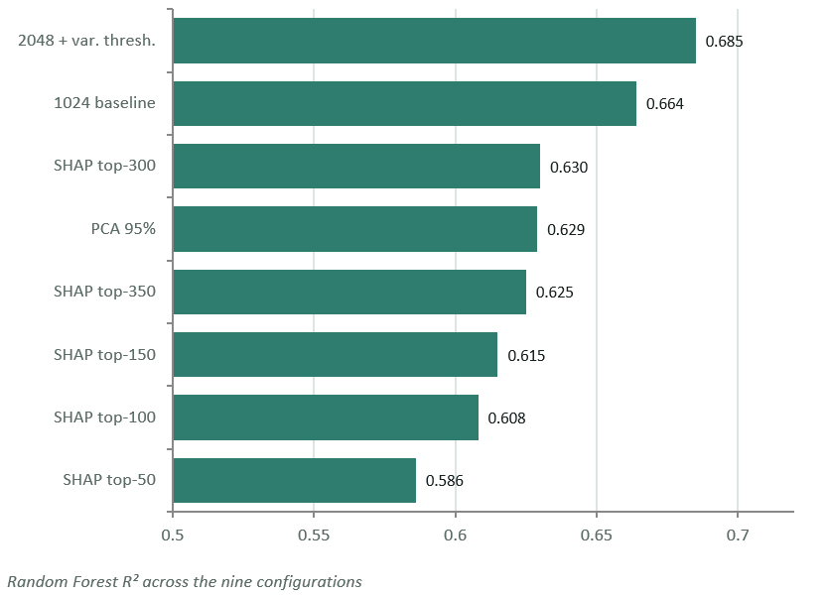
4 · RESULTS
13
Feature selection and hyperparameter tuning
Neither improved on the untuned full-representation baseline
Grid search gained nothing
Model | Default | Tuned
Random Forest | 0.664 | 0.668
XGBoost | 0.653 | 0.669
Bagging | 0.634 | 0.671
Lasso | −0.006 | 0.589
Signal is distributed
All 497 features carry non-zero attribution; the top 20 hold only 54% of it, so reduction costs real information.
Recorded issue: the two PCA runs and the Lasso-selection run produced identical output files and must be re-run.
s

Slide 11
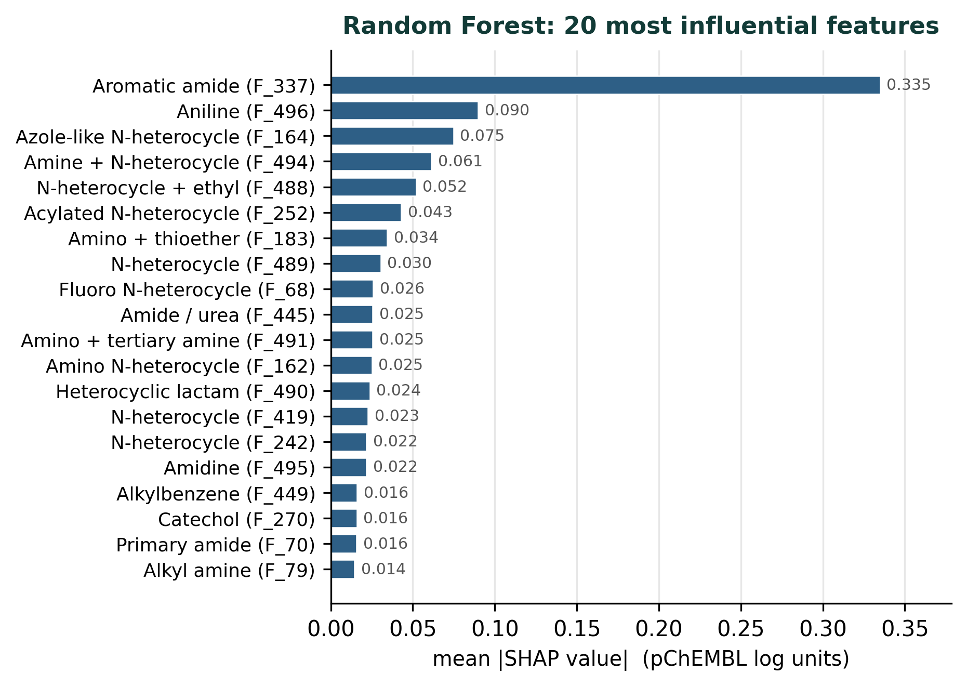
4 · RESULTS
14
SHAP interpretability analysis
Attributions computed over 470 compounds and 497 features
12 of 20
top-ranked features shared between the Random Forest and Gradient Boosting rankings — two algorithms that build ensembles in completely different ways
18.7%
of total Random Forest attribution carried by feature Aromatic amine alone, more than three times the second-ranked feature
Random Forest regressor — 20 features with the highest mean absolute SHAP value

Slide 12
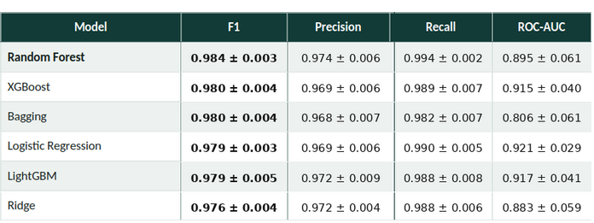
4 · RESULTS
15
Classification performance
Hold-out evaluation on 705 test compounds, ordered by F1
The apparent reading
Every model scores above 0.976 on F1, balancing precision and recall on the active class. Random Forest leads, and the task looks solved.
The F1 scores cluster within 0.008 of one another, from 0.976 to 0.984. Under stratified ten-fold cross-validation they compress further still, to 0.975–0.980, with fold-to-fold standard deviations of 0.003 to 0.007 — larger than the entire spread between models. On this evidence the six classifiers are statistically indistinguishable.

Slide 13

4 · CONCLUSION
13
Conclusions and future work
What the study establishes, and what remains to be done
0.685
0.655
18.7%
Best cross-validated R²
2048 bits with variance thresholding
Log-unit RMSE — a 4.5-fold
uncertainty in predicted potency
Of total attribution carried
by feature aromatic amide group(337) alone
What the results establish
Tree ensembles win as a class rather than individually
— Random Forest, XGBoost and Bagging fall within one
standard deviation of each other. Neither feature selection nor grid
search improved on the untuned baseline: the signal is distributed
across the representation.
Attribution is stable — 12 of 20 top features agree across two algorithms

Slide 14
5 · REFERENCES
14
References
Published sources underpinning the methodological choices made in this study
Representation, data and tools
Learning algorithms
Evaluation and interpretation
Hansch, C. & Fujita, T. (1964) ρ-σ-π analysis. J. Am. Chem. Soc., 86, 1616–1626.
Rogers, D. & Hahn, M. (2010) Extended-connectivity fingerprints. J. Chem. Inf. Model., 50, 742–754.
Mendez, D. et al. (2019) ChEMBL: towards direct deposition of bioassay data. Nucleic Acids Res., 47, D930–D940.
Landrum, G. RDKit: open-source cheminformatics. www.rdkit.org
Pedregosa, F. et al. (2011) Scikit-learn. JMLR, 12, 2825–2830.
Breiman, L. (1996) Bagging predictors. Machine Learning, 24, 123–140.
Breiman, L. (2001) Random forests. Machine Learning, 45, 5–32.
Friedman, J. H. (2001) Greedy function approximation. Ann. Statist., 29, 1189–1232.
Chen, T. & Guestrin, C. (2016) XGBoost: a scalable tree boosting system. KDD '16, 785–794.
Ke, G. et al. (2017) LightGBM. NeurIPS, 30.
Tibshirani, R. (1996) Regression shrinkage and selection via the lasso. J. R. Stat. Soc. B, 58, 267–288.
Lundberg, S. M. & Lee, S.-I. (2017) A unified approach to interpreting model predictions. NeurIPS, 30, 4765–4774.
Chicco, D. & Jurman, G. (2020) The advantages of the Matthews correlation coefficient over F1 score and accuracy. BMC Genomics, 21, 6.
Bemis, G. W. & Murcko, M. A. (1996) The properties of known drugs. 1. Molecular frameworks. J. Med. Chem., 39, 2887–2893.
Software
RDKit · scikit-learn · XGBoost · LightGBM · SHAP · pandas · NumPy · Matplotlib

